Slide 1


LOaPP: Improving the performance of Persistent Memory Objects via Low-Overhead at-rest PMO Protection
Derrick Greenspan, Naveed Ul Mustafa, Andres Delgado, Connor Bramham, Christopher Prats, Samu Wallace, Mark Heinrich, Yan Solihin
SEED 2024
Notes:
Hello, I’m Dr. Derrick Greenspan, a post-doctoral fellow under Dr. Choi’s lab here at the University of Central Florida, and today I am presenting our paper here at SEED 2024, LOaPP: Improving the performance of Persistent Memory Objects via Low-Overhead at-rest PMO Protection.

Slide 2
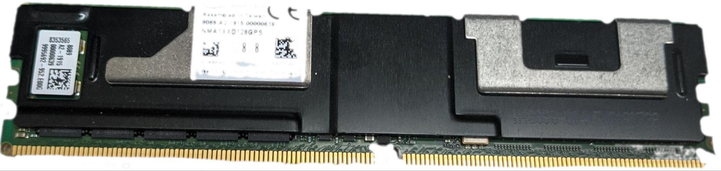
Persistent Memory (PM)
Durable, Byte addressable, Storage Class
Methods of utilizing PM
Memory mapped files
Needs file system
Map files into user space of process
Persistent Memory Objects (PMOs)
No filesystem, little metadata
Map PMO address space into process
Implemented in Improving the Security and Programmability of Persistent Memory Objects (SEED 2022)
Notes:
To begin with, we have to discuss what Persistent Memory, or PM is, in order to understand this work. PM is byte-addressable memory like DRAM, but it’s durable and has storage class level performance. One example of PM is Intel Optane PM, which has been discontinued, but further research on PM technologies, especially with the advent of CXL memory, continues.
There are two primary methods of utilizing PM. First, and most commonly, PM can be accessed via memory mapped files with a file system. This design maps files into the user space of a process, but it’s lacking because it has different semantics (file system vs virtual memory) and requires serialization/deserialization to use. An alternative method is known as Persistent Memory Objects (PMOs). The address space of PMOs are mapped into the address space of the process and accessed like any other type of persistent data. This approach is therefore intuitive to the programmer because it does not suffer from the aforementioned differing semantics.

Slide 3
Background: What is a PMO?
A persistent memory object that holds pointer rich data structures without any file-backing.
It can be located in a single contiguous PM region or span multiple regions.
Provides crash consistency, security, and integrity verification
PM
PMO
Region 1
PM
PMO
Region 2
Region 3
Notes:
A PMO is, specifically, a persistent memory object that holds pointer rich data structures without any file backing. A PMO can be located in a single contiguous region or span multiple regions of a PM, and provides crash consistency, and optionally security and integrity verification, and we’ll explore how in the upcoming slides.

Slide 4
Background: PMO API
attach () - Render PMO accessible
detach () - Render PMO inaccessible
psync () - Force modifications to PMO to be persistent
struct node *c = attach (head, ‘w’);
while (c->next != NULL && NODE_HAS_DATA(c)) c = c->next
if (c->next == NULL) c->next = new_node;
else {tmp = c->next; c->next = new_node; c->next->next = tmp;}
psync (head);
detach (head);
Linked list node insertion with psync
Notes:
As a brief background, there are three components to the PMO API. There are attach, which renders a PMO accessible, detach, which renders a PMO inaccessible, and psync, which forces modifications to the PMO to be crash consistent. The programmer may use psync as illustrated here. A linked list node can be inserted and then rendered crash consistent with psync. If a crash happens, there is always a consistent copy of the data. In our design, we use shadowing to achieve crash consistency for PMO where each PMO has a primary and shadow copy for each accessed page. All updates are performed on the shadow copy. If a crash happens, the Primary PMO has a consistent copy.

Slide 5
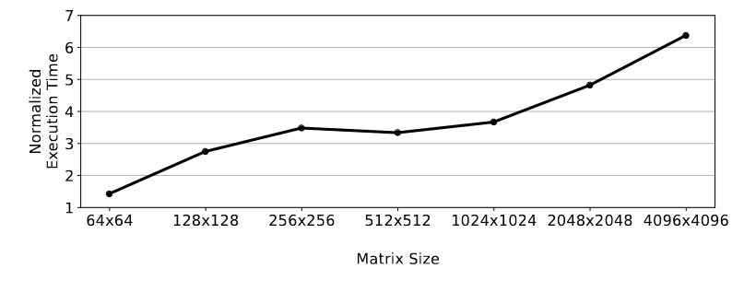
Problem with Whole PMO Granularity
PMOs can be encrypted and have an associated checksum
Size of PMO dramatically affects time to decrypt at attach
Original design enforces protections at Whole PMO granularity
As PMO size increases, so does overhead
Notes:
Optionally, PMOs can be encrypted and have an associated checksum for security and reliability. The encryption can be done in a crash consistent manner, which prior works have demonstrated, and which we will discuss later as it relates to our current work. The most important thing to note is that the size of a PMO dramatically affects the time it takes the PMO to decrypt at attach, and this is a consequence of the fact that the original design from prior work enforces protections at the granularity of a whole PMO rather than at page level.
For example, this graph shows the size of a matrix inputted into a Tiled Matrix Multiplication program, and the execution time normalized to a system with no encryption. We can see that at a size of 64x64, a system with encryption takes about 1.3 times the amount of time that it took without encryption. But at a matrix size of 4096x4096, it took 6.5 times the amount of time that it took without encryption, which is quite significant. The source of these problems is that the prior design enforces protections at the granularity of a whole PMO, irrespective of the actual size of a single attach session.

Slide 6
Proposed Solution
LOaPP (Low Overhead at-rest PMO Protection)
Change the granularity, from the whole PMO to individual pages
Decrypt pages at page fault instead of attach
Store the checksums of each page instead of whole PMO
Important questions
WHAT to decrypt?
WHEN to decrypt/verify during a session?
HOW to retain checksum integrity?
Notes:
So, we need a new approach. Enter… LOaPP, or Low Overhead at-rest PMO protection
The main idea of LOaPP is to change the granularity, from whole PMO to the size of individual pages. Instead of decrypt pages at attach time, we can decrypt pages on demand at fault, and store the checksums of each page instead of the entire PMO.
This leads to three important questions that our work wants to address
First, we ask, what do we want to decrypt/verify? Do we just want to decrypt only the shadow, or both the shadow and the primary? Second, we ask when we should decrypt/verify during a session. Finally, we ask how we can retain checksum integrity.

Slide 7
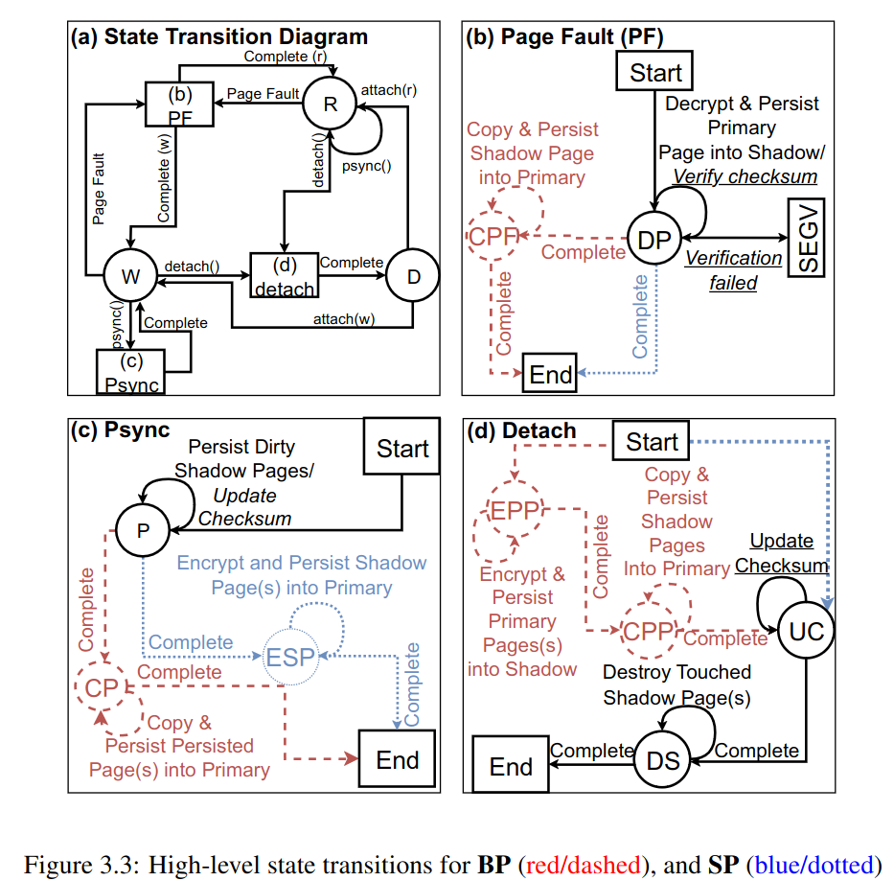
Design space - WHAT
What to decrypt?
What to checksum?
Notes:
So let’s explore the design space. First, we ask WHAT. What to decrypt, and what to checksum?
Regarding what to decrypt, we have options. We can decrypt the whole PMO, which is the base design from prior work, or we can decrypt only the shadow page, or both the shadow and the primary. If we decrypt the whole of the PMO, we incur the latency of decrypting the entire PMO at attach time. Since we anticipate that programmers will attach/detach PMOs frequently, this latency adds up if the PMO is large. The other two options have various pros and cons. If we decrypt the primary into the shadow only, the SP design, then page faults are faster and so is detach. Page faults only require one decryption call and no write back, while detach needs only to delete the data that are in the shadow. On the other hand, psync is slightly slower because the shadow copy must be encrypted back into the primary rather than simply copied.
The other option is to decrypt the primary into the shadow and then copy the shadow back to the primary, or the BP design, for both pages. Psync in this design is as fast as it was in the original, but now detach and page faults are slower, particularly detach since any extant page must be reencrypted. Page faults, too, are slower, because after a fault, the page must be decrypted into the shadow and then copied back into the primary.
If you look at the figure to the right, you can see state transition diagrams for page fault, psync, and detach. Red lines indicate both primary and shadow are decrypted, the BP design, while blue lines indicate that only shadow pages are decrypted. Black lines are common for both designs. As you can see, when a page fault occurs, decrypting and persisting the primary into the shadow is all that is necessary for the shadow only design, but when a page fault occurs for the both primary and shadow design, it must be copied back into the primary. Similarly, as mentioned earlier, when a psync occurs, the design is simpler for both: in fact it is unchanged from the previous design, while when using shadow only, the shadow must be encrypted back into the primary. Detach, as mentioned is very simple (just destroy touched shadow pages) when using SP, but more complicated for BP.
Regarding what to checksum, we also have options. We can checksum the entire PMO, which is the base design from prior work, or we can checksum only those pages that have been modified. We will discuss the pros and cons of each soon.

Slide 8
Design space - WHEN
When to verify?
At attach (Base design from SEED 2022)
At page fault
When to update checksum:
At psync time (Base design from SEED 2022)
Slower, innate crash consistency
At detach time
Faster, requires crash handler
Notes:
The second question is WHEN should we verify the checksum, and when should we update it? If we’re using our new design, then we have to verify the checksum at page fault, but the original design did so at attach instead. Then, we need to update the checksum, which we can do either at psync time, the base design from SEED 2022, or at detach time. Verify the checksum at every psync is slower for the obvious reason that there will most likely be more checkpoints than detaches, but if we verify the checksum at detach time, then we have to have a crash handler to ensure the checksum data are always crash consistent.

Slide 9
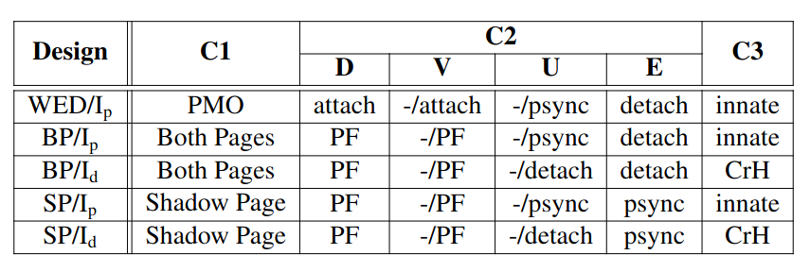
Design space summary
C1: What is decrypted/encrypted/verified?
C2: When does this occur? (D – Decrypt, V – Verify, U - Update Checksum, E- Encrypt)
C3: How should IV crash consistency be handled? Innate vs. Crash Handler required
Notes:
Putting all of this together, here is a summary of the design space, assuming the use of integrity verification in all cases. From left to right, we have Design, What is operated on (category 1), Category 2, which consists of WHEN it is operated on, and broken into different components such as decrypt, verify, update checksum, and encrypt, and finally we have Category 3, which discusses how crash consistency should be handled.

Slide 10
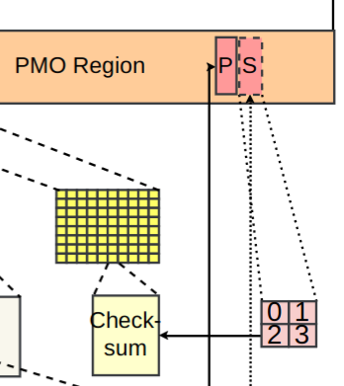
Per-page checksum
Checksum has to be stored somewhere!
New region: Checksum region
Each page has associated checksum
Small overhead: 1%
Notes:
As discussed earlier, we want to improve the performance of PMOs by splitting them into individual pages, both encryption and checksums. To do this, we need to change where we store the checksum from being part of the metadata for the PMO itself to being in a separate section. To do this, we propose creating a new, separate region, the Checksum region. Each page as an associated checksum within the region; since each checksum is 32 bytes large, this creates a small overhead.

Slide 11
Implementation
Kernel Crypto API
Inherently multi-threaded
Multiple pages encrypted & copied in parallel
Crash Handler
Invoked whenever the process dies via do_exit() kernel function call
Notes:
Finally, we have the implementation. The implementation is fairly straightforward. Like in prior work, we use the Kernel Crypto API, which is inherently multithreaded, and allow multiple pages to be encrypted & copied in parallel. The kernel crypto API effectively runs as a separate thread and dispatches decryption and encryption calls to the encryption engine. In this way, breaking up pages and decrypting on page fault can improve performance dramatically.
In addition, we implemented the crash handler, which encrypts the entire PMO and updates the checksum of each page whenever a process dies abnormally. This is only strictly necessary when we relax the integrity verification to perform checksum updates at detach as described earlier

Slide 12
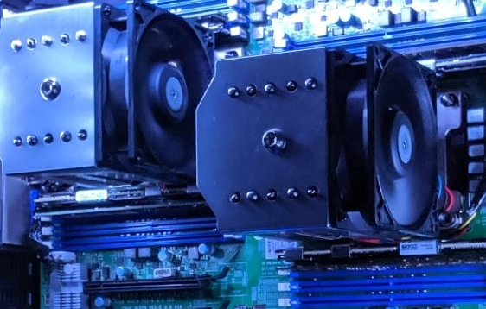
Evaluation methodology
Use modified Linux kernel 5.14.18
Use actual PM system (pictured)
Benchmarks:
Microbenchmarks
LU, 2dConvolution (2dConv) Gauss, Tiled Matrix Multiplication (TMM)
Filebench
Fileserver (FS), Webserver (WS), Webproxcy (WP), Varmail (VM)
Notes:
To reiterate, this paper implemented PMOs using real hardware. The system in question is pictured here. We modified the Linux kernel version 5.14.18, the same version as in prior work. We evaluated four microbenchmarks and four filebench workloads. We’ll discuss the results in the next section.

Slide 13
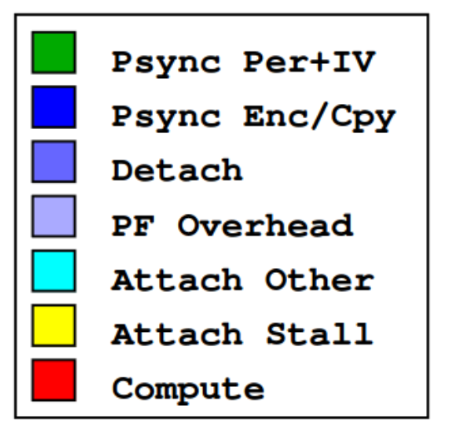
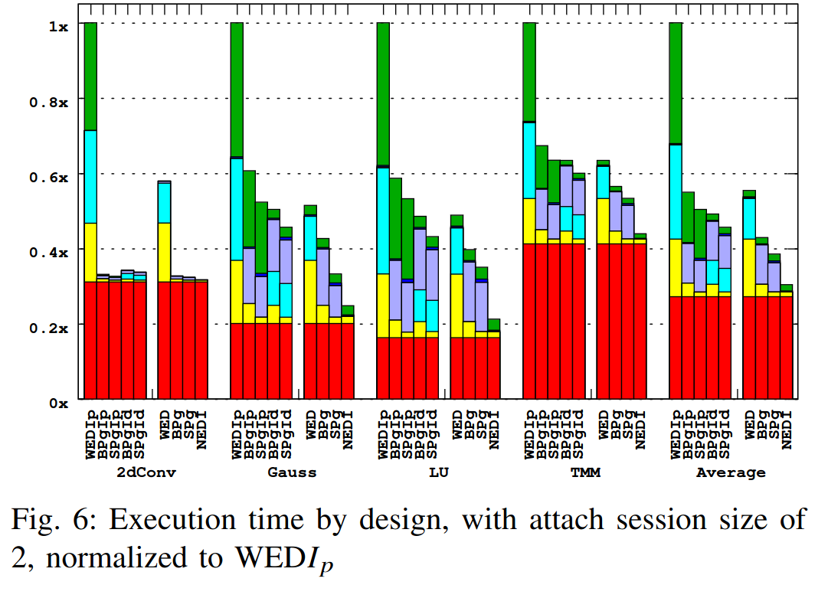
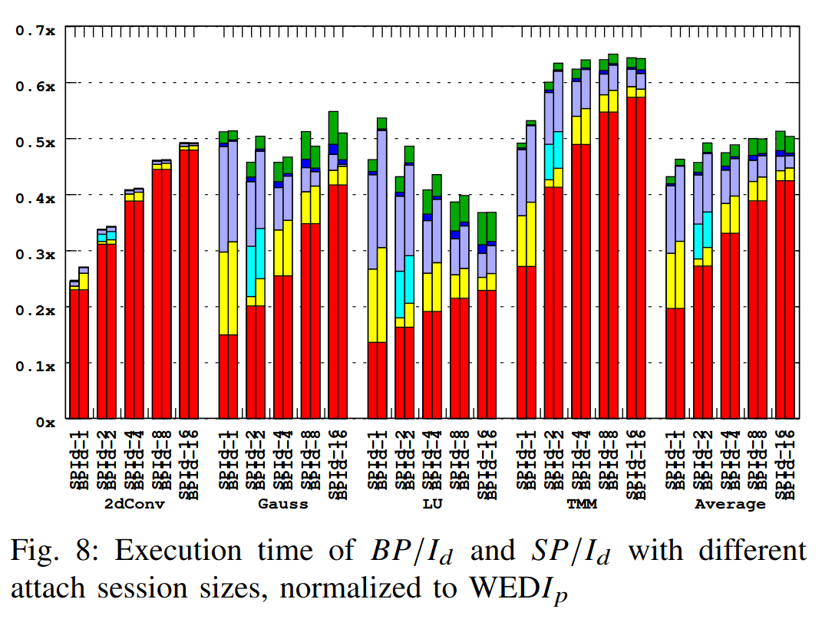
Evaluation - microbenchmarks
Best design (SP) 2.62x faster than base design
BP slightly faster (3%) when attach/detach infrequent
Notes:
For the evaluation, we want to answer a few questions. First, we want to determine how much more performant LOaPP is compared to the baseline Whole Encryption design. Second, we want to determine if keeping the primary and shadow decrypted (BP) are more performant, or if only decrypting the shadow page is superior. We also want to determine whether updating the checksum at detach is fast enough to warrant requiring the crash handler, or whether the difference is so insignificant that it is unimportant.
(click)
Before I describe the results, the legend on the far left color codes the different components of the execution time. They are split into different categories,Psync persist and integrity verification, Psync Encrypt/Copy, Detach, PF Overhead, Attach Other, Attach Stall, and Compute.
(click)
The next figure shows the execution time by the different designs, from Whole Encryption + IV to the original no encryption design. This figure shows that on average, decrypting only the shadow page is faster, as long as attach/detach are called often. For example, if after every other psync we detach and then reattach the PMO, we see that this design is about 3% faster. However, both designs work well, much better than the original whole PMO encryption design: on average both are more than two times faster.
(click)
This figure focuses on the two most performant designs as the attach session size increases, normalized to SP/Id with an attach/detach session size of 1. At a size of 16, decrypting the primary and the shadow together are slightly faster, 2.7%, because psync is less expensive.

Slide 14
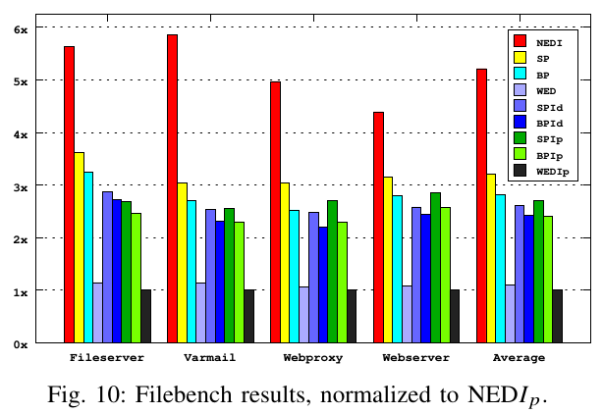
Evaluation - Filebench
SP/Id is 2.56x faster than the base design
Notes:
Finally, we evaluated the different designs with Filebench. High numbers are better here, since they indicate higher bandwidth. There are a few takeaways here. First, the most performant design with integrity verification from the previous slide, SP/Id, is 2.56x faster than the base design with encryption and IV. Second, adding integrity verification to whole encryption doesn’t reduce performance by a significant amount. Third, there are some scenarios where updating the checksum at detach can be worse than at psync, for example, Webserver is worse when using SPIVd because it calls detach more often than psync: writes only occur 9% of the time. Hence, if the workload is heavily biased towards reads, then it may be beneficial to not update the checksum at detach, and instead update it at psync.

Slide 15

THANK YOU!
Any Questions?
Notes:
Thank you! Do you have any feedback for me?

